Slide 1
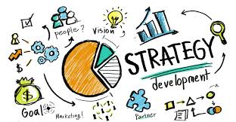
Supporting Business Strategies with Analytics

Slide 2
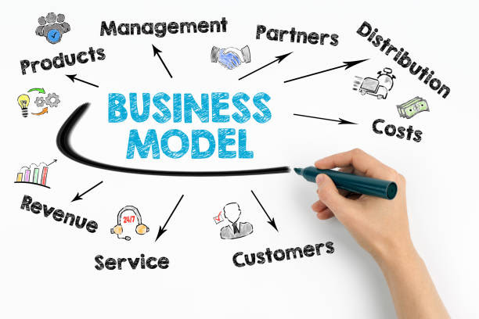
Business Models
A business model identifies “a firm’s value proposition for its various stakeholders and the activity system the firm uses to create and deliver value to its customers.”
From the company’s perspective, the business model is what the company does to generate revenues, decrease costs, and grow profits; that is, make money. For customers, it is why they buy the company’s products and services.

Slide 3
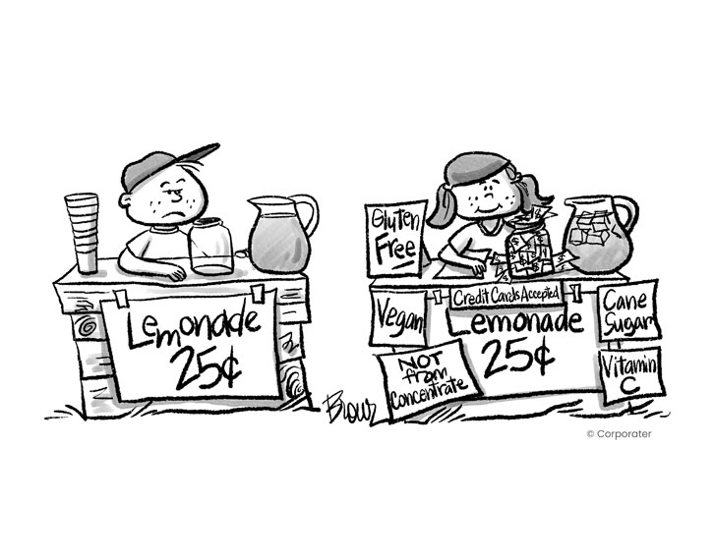
Business Strategies Focus on the Specifics of How to Execute and be Successful with the Business Model
Cost leadership
Product or service differentiation
Niche differentiation
Market expansion
Diversification

Slide 4
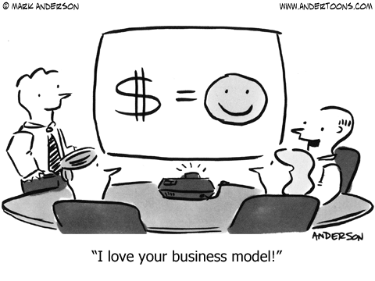
What Are the Business Strategies for These Companies?
Walmart
Southwest Airlines
Amazon
Mercedes
Trader Joes
Add Drugstore

Slide 5
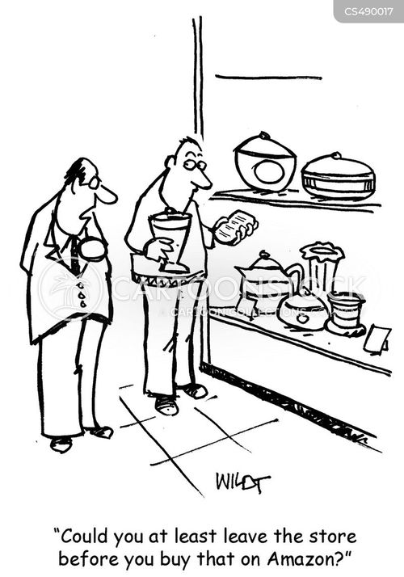
Always be on the Look for Market Disruptors
New technologies
Blockbuster
Smartphones
New entrants to a marketplace
Airbnb
Uber

Slide 6

Strategies, Business Processes, and Work
Business processes are critical to executing the business strategies
Individuals perform business process work
Analytics play a key role in business processes design

Slide 7
Premier Airlines
Business Model: Be fliers favorite airline
Business Strategy: Provide the best possible flying experience
Business Process: Passenger check-in

Slide 8
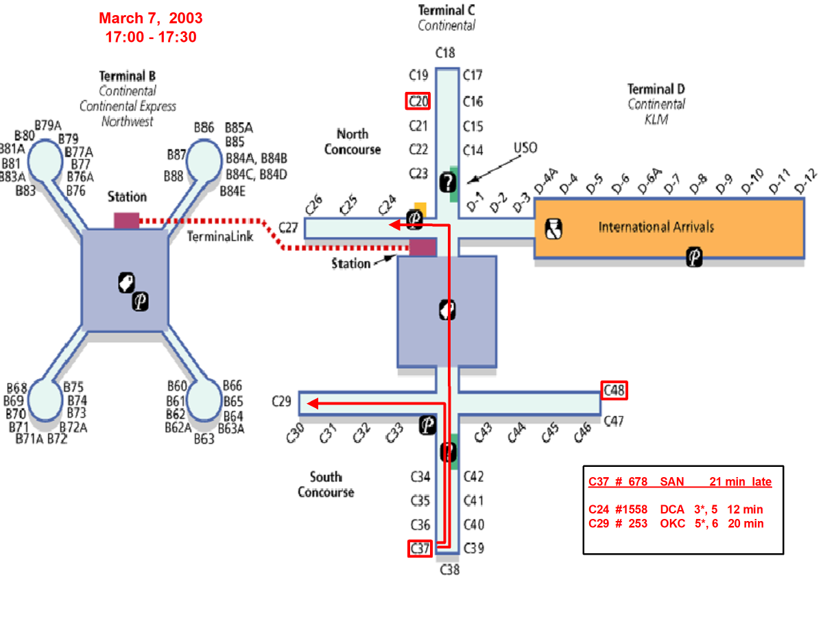

Slide 9
Premier Airlines
Business Model: Be fliers favorite airline
Business Strategy: Provide the best possible flying experience
Business Process: Passenger check-in gate
Business Process Analytics: Analyze social media to learn about customer complaints and recommendations for improving the check-in process

Slide 10



Maturity Models
(also known as)
Different Targets
Generational Models
Stages of Growth

Slide 11
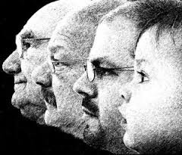
Analytics Maturity Models
A popular way of describing and understanding change
Each stage in a maturity model represents a significant evolution
While every stage is defined by multiple characteristics, there are salient characteristics that are most significant
Organizations normally progress systematically from stage to stage
There are different maturity models

Slide 12
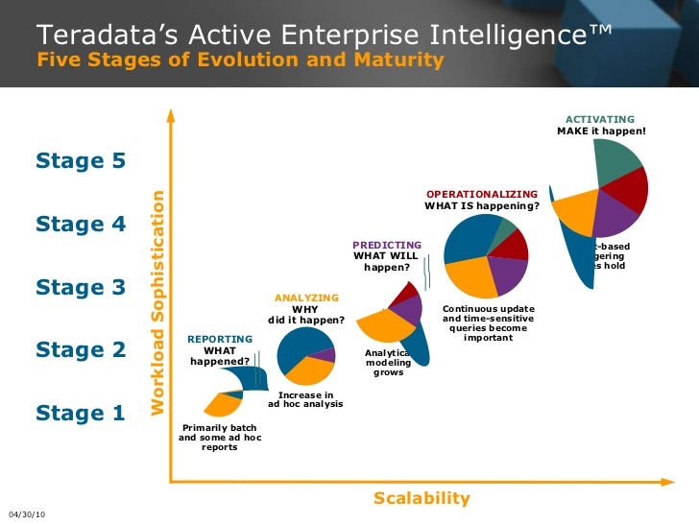

Slide 13

Target Model
There are different “targets” for analytics
Notes:
Companies can have different “targets” or approaches to analytics. No one target is better for all firms, and each target can be best for a particular company depending on its situation. All of the targets can potentially deliver significant business value.

Slide 14

A single or a few applications
A point solution
May be departmental
Serves a specific business need
A possible entry point
Notes:
One target is to develop a single or a few analytic applications. These applications are typically departmental solutions and satisfy specific business needs. For example, a company may use analytics to identify customer segments for more targeted marketing campaigns. These applications are not necessarily developed in-house. There are a growing number of analytic applications and services that are offered by third parties, either as a service over the Internet or on a consulting basis. The services approach is an especially appealing option for smaller companies that do not have the necessary in-house resources for advanced analytics.
A single or a few applications is a common starting point for analytics in most companies. While satisfying a business need, the initial applications can also serve as a proof of concept for analytics. Over time, there are more point solutions and management becomes aware of the need to take a more holistic approach.

Slide 15
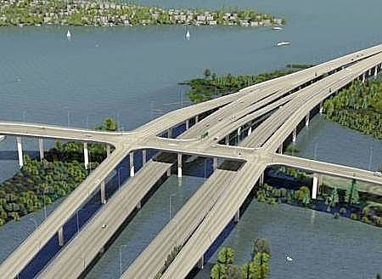
Enterprise analytical capabilities
The software/hardware infrastructure is created for enterprise-wide analytics
Analytics are used throughout the organization
Analytics are key to business success
Notes:
With enterprise-wide analytics, a company puts resources, organizational structures, and processes around analytics. The infrastructure (e.g., data, software) is created to do analytics on a company-wide basis. Given this infrastructure, analytics is used throughout the organization and is often a key to business success. Later we will discuss the various component parts of this infrastructure. From a BI maturity curve perspective, companies that are doing analytics enterprise-wide have progressed to an advanced stage of maturity.

Slide 16

Organizational Transformation/The Analytics-Based Organization
The firm adopts a new business model enabled by analytics
Brought about by opportunity or necessity
Analytics are a competitive requirement
Notes:
The final target, organizational transformation, is brought about by either opportunity or necessity. The company adopts a new business model in reaction to market realities and the model cannot be executed without the extensive use of analytics. The business and analytics strategies are intertwined and analytics is a requirement for business success. We will later see examples of this with Harrah’s and First American Corporation.

Slide 17
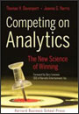
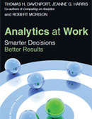
Conditions that Lead to Analytics-Based Organizations
The nature of the industry
Seizing an opportunity
Responding to a problem
Notes:
There are several reasons that some companies are heavily committed to analytics – the nature of the industry in which they compete, an opportunity, or a critical business problem.
Tom Davenport in his books, Competing on Analytics (with Jeanne G. Harris) and Analytics at Work (with Jeanne G. Harris and Robert Morison), has shown how a variety of companies are benefiting from analytics.
An analytics readiness or success factors perspective provides another lens for considering what is required in order to become a successful analytics-based organization. This perspective identifies what is already or should be put in place in order to be successful. The following can be identified as requirements for advanced analytics:
A clear business need
Strong, committed sponsorship
Alignment between the business and IT strategy
A fact-based decision making
A strong data infrastructure
The right analytical tools
Strong analytical personnel in an appropriate organizational structure

Slide 18

The Nature of the Industry: Online Retailers
BI Applications
Analysis of clickstream data
Customer profitability analysis
Customer segmentation analysis
Product recommendations
Campaign management
Pricing
Forecasting
Dashboards
Notes:
Online retailers like Amazon.com and Overstock.com are great examples of high volume operations who rely on analytics to compete. As soon as you enter, their sites a cookie is placed on your PC and all clicks are recorded. Based on your clicks and any search terms, recommendation engines decide what products to display. After you purchase an item, they have additional information that is used in marketing campaigns. Customer segmentation analysis is used in deciding what promotions to send you. How profitable you are influences how the customer care center treats you. A pricing team helps set prices and decides what prices are needed to clear out merchandise. Forecasting models are used to decide how many items to order for inventory. Dashboards monitor all aspects of organizational performance.

Slide 19

“We are a business intelligence company”
Patrick Byrne,
CEO, Overstock.com
Notes:
When I interviewed CEO Patrick Byrne and asked him to describe Overstock.com, I expected him to say it was an “online retailer” or perhaps an “information-based company”. Instead, he said that it is a “business intelligence company”. That is how Overstock.com competes in the marketplace, as does other large online retailers.

Slide 20

Seizing an Opportunity: Harrah’s
In 1993, the gaming laws changed
Harrah’s decided to compete and expand using a brand and customer loyalty strategy
Notes:
Harrah’s was originally the “blue collar” casino where everyone knew your name. When the gaming laws changed, Harrah’s adopted a new business model that included expansion, creating a brand identity, and the industry’s first loyalty program, Total Rewards. Gary Loveman, a Harvard marketing professor, was brought in to drive this new business strategy. Key to this new model was analytics using an operational store and a data warehouse. It allowed Harrah’s to perform analytics in order to know who its customers are, where they gamble, what games they play, their profitability, and what offers to make to get them to return.

Slide 21
Seizing an Opportunity: Harrah’s
Implemented WINet with an ODS and DW
Offered the industry’s first customer loyalty program, Total Rewards
A tiered reward system– Gold, Platinum, Diamond, and Seven Stars
Notes:
Harrah’s was originally the “blue collar” casino where everyone knew your name. When the gaming laws changed, Harrah’s adopted a new business model that included expansion, creating a brand identity, and the industry’s first loyalty program, Total Rewards. Gary Loveman, a Harvard marketing professor, was brought in to drive this new business strategy. Key to this new model was analytics using an operational store and a data warehouse. It allowed Harrah’s to perform analytics in order to know who its customers are, where they gamble, what games they play, their profitability, and what offers to make to get them to return.

Slide 22

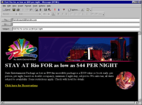


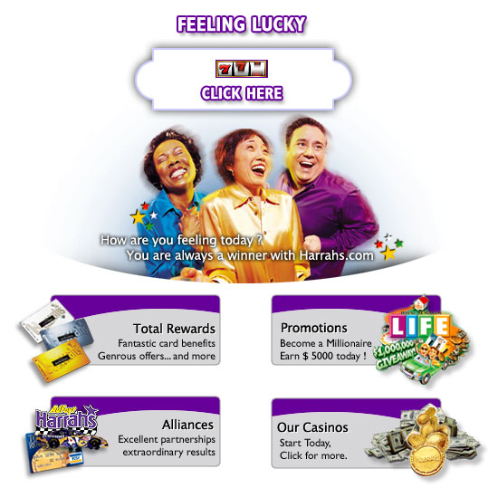

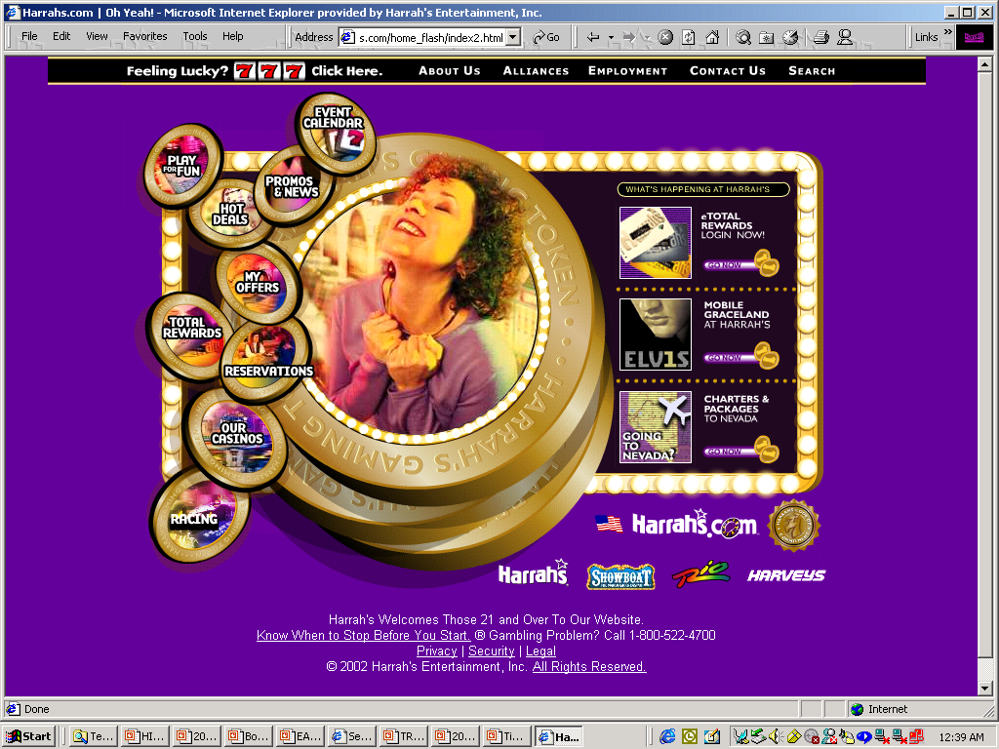


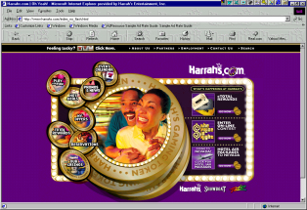
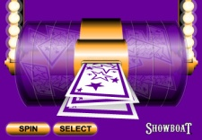
Total Rewards: The Guest Experience
Our goal is to have consistent interactions via multiple touch points
Our Games
Call Centers
Guest Communication
Welcome Message
Reward Credits shown upon card-in
Slot Service / SSD
Rated Table Play
National and VIP/Local
Hotel and event booking
“Reserve” Offers & Rewards
Events and Registration
Info / Q&A (via Factbook)
Direct Mail Offers
Email Offers
Web Offers
Teleservices Offers
VIP Hosts / PCS
GSW
GSW
Our Guests
Harrah’s CRM Systems
Slots
Casino
Our Card
Tables
WINet
PDB+EDW
Kiosk
Hotel
Our Employees
Web
Java /
EBiz
Issue Total Reward Card
Explain Program & Promos
Issue Cash and Comps
Hotel Check in / out
Diamond / VIP Hosts
Events, Promotions, Entmt
Slot and Table services
Food, Beverage & Retail POS
Call Ctr
Marketing
Workbench
Our Kiosks
Display Credits & Comps
Issue Comp / Credit vouchers
Reissue Total Rewards Cards
Display /Update eTR & Offers
Promotions Entries and Activations
Our Website
Our Interaction
eTotal Rewards
Web Book-it / YOW
Play for Fun Online
Enterprise Promotions
Player Contact System
Slot Service Dispatch

Slide 23
Seizing an Opportunity: Harrah’s
Fact based decision making replaced “Harrahisms”
Today it is the largest gaming company in the world
Renamed Caesars
Notes:
The managers of the Harrah’s properties used to run their casinos as private fiefdoms and decisions were made based on “Harrahisms” – things that were just assumed to be true. With the new business model, decision making became much more centralized and was based on constant experimentation of what worked best (i.e., fact based decision making). The success of this approach is seen in Harrah’s now being the largest gaming company in the world. The “blue collar” casino bought the more upscale Caesars in 2004 and changed its corporate name to Caesars in 2010. Quite a success story. Many of the people who were successful with Harrah’s original uses of analytics were hired by other casinos and spread the use of analytics throughout the gaming industry.

Slide 24
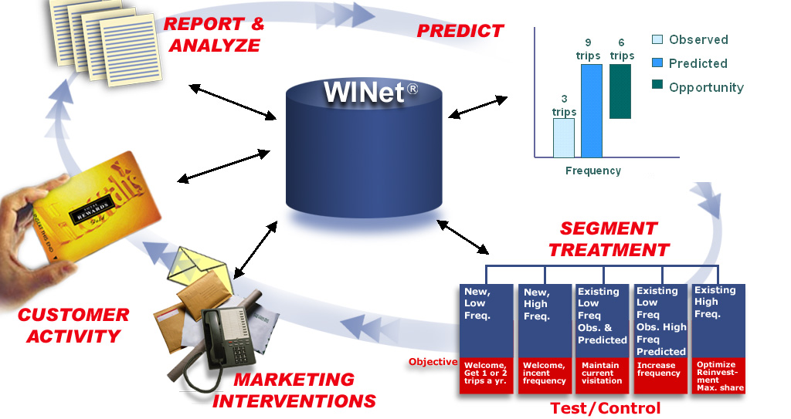
Closed Loop Infrastructure
Powers CRM
Gaming Behavior
Predicted
Actual
Demographics
Other Detail Trans
Marketing Actions

Slide 25

Responding to a Problem: First American Corporation
First
American
The bank was failing
A new management team stopped the bleeding
A customer intimacy strategy was implemented, Tailored Client Solutions
Notes:
First American was a regional bank headquartered in Nashville, TN. Don’t look for it now, it has been bought and renamed several times. The bank had lost $60M and was operating under letters of agreement with regulators. It had serious problems. A new management team was brought in that cut costs and stopped the bleeding. Management knew, however, that it needed a new business strategy if the bank was to survive. As it explored its options (e.g., being a low cost provider), it realized that it best bet was a customer intimacy strategy (supported by analytics) because of the information it had about its customers that other banks didn’t. This strategy was called Tailored Client Solutions.

Slide 26
Notes:
Tailored Client Solutions was focused on the client (i.e., the customer) and had four component parts.

Slide 27
Responding to a Problem: First American Corporation
The business strategy was enabled by a data warehouse called VISION and analytics
First
American
Notes:
A data warehouse and extensive analytics were required to implement the new business strategy.

Slide 28
Notes:
The data warehouse was called Vision and was very customer centric. It contained a variety of data (e.g., psychographic, transactions) from different source systems (e.g., operational, third party).

Slide 29
Responding to a Problem: First American Corporation
External talent was brought in as needed
Applications using VISION were developed for every component of TCS
The bank was transformed from “banking by intuition” to “banking by information and analysis”
First
American
Notes:
A heavy dose of consultants and professional services were brought in to quickly build the warehouse and do the customer and product profitability analyses. Small teams also worked on developing applications in each of the TCS application areas. Each of the applications provided financial “lift” and gave credence to this new approach to running the bank. Decision making became fact based. The bank moved from financial disaster to being a leader in the financial services industry.
A few companies move quickly to advanced analytics, most typically driven by necessity. This was the case at FAC, where survival of the bank was at stake. To make the jump to an advanced stage, FAC invested heavily in consultants and vendors’ products and professional services. The providers of these resources knew what needed to be done and FAC was willing to make the necessary financial and other commitments. Another example is the Cosmopolitan of Las Vegas, the latest hotel/casino to open on the Strip. It entered a market where Harrah’s and other leading casinos already had outstanding analytics programs in place. It was able to quickly move into advanced analytics by using vendors that already had gaming specific industry offerings (e.g., the Teradata hospitality/gaming data model) and hiring people with analytics experience in other casinos.

Slide 30
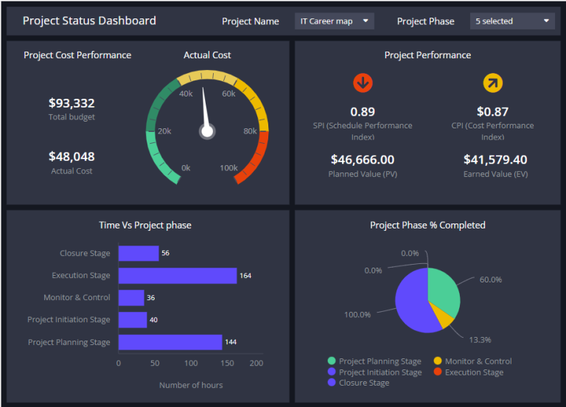
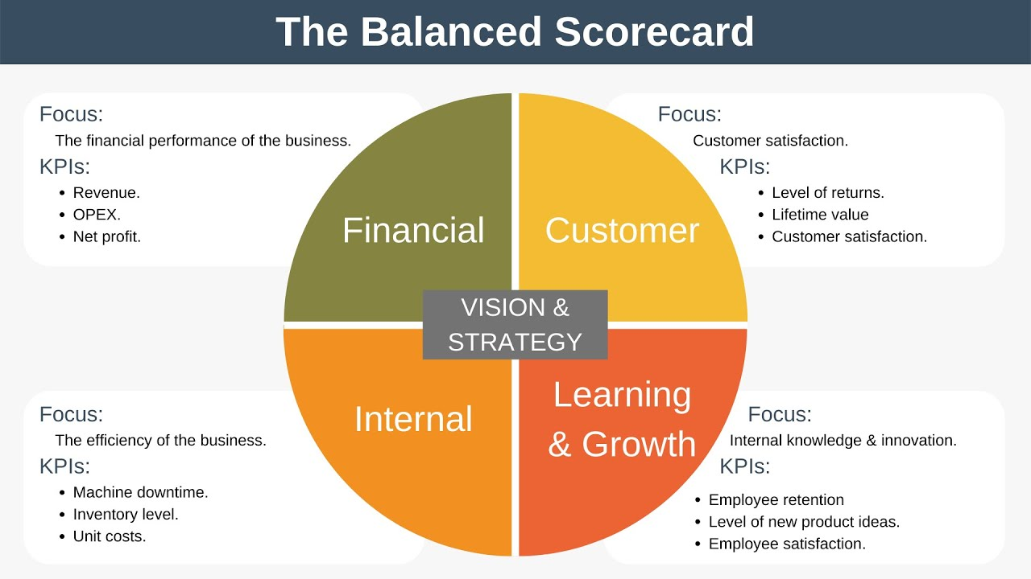
Dashboards, and Especially Scorecards, Support the Execution of the Analytics Strategies

Slide 31
The Evolution of Dashboards and Scorecards
CSFs were used in the 1970s
Executive information systems included CSFs
Today, we refer to key performance indicators (KPIs) or performance metrics
These metrics are displayed in dashboards and scorecards
The BI infrastructure and tools provide the necessary analytical capabilities for dashboards and scorecards
Data warehousing provide the needed data infrastructure

Slide 32
Let’s start with some general definitions…
A dashboard is an online reporting tool that can address a range of performance management problems.
Dashboards enable organizations to measure, monitor, and manage business activity using both financial and non-financial measures
Dashboards provide both numerical values as well as visualizations of the data along with text commentary
Dashboards provide both “static” views of the data as well as “interactive” analytical capabilities (often referred to as “drill-down”)
Contemporary dashboards identify trends, provide forecasts, send alerts, identify root causes

Slide 33
What is a scorecard…
A scorecard is a type of dashboard where the information displayed is derived from the use of a structured methodology such as the Balanced Scorecard or Objectives and Key Results (OKR)
Strategy maps evolved later, and are designed to link the metrics used on the scorecards to the business strategies
The metrics are for key performance metrics, business processes, projects, and decisions

Slide 34
The Balanced Scorecard
Provides a balanced presentation of both financial and operational measures
The classic balanced scorecard uses four perspectives
Financial
Internal business
Innovation and learning
Customer
Performance is compared to past performance, goals and plans, benchmarks, and best practices
Ties performance metrics to the business strategy

Slide 35
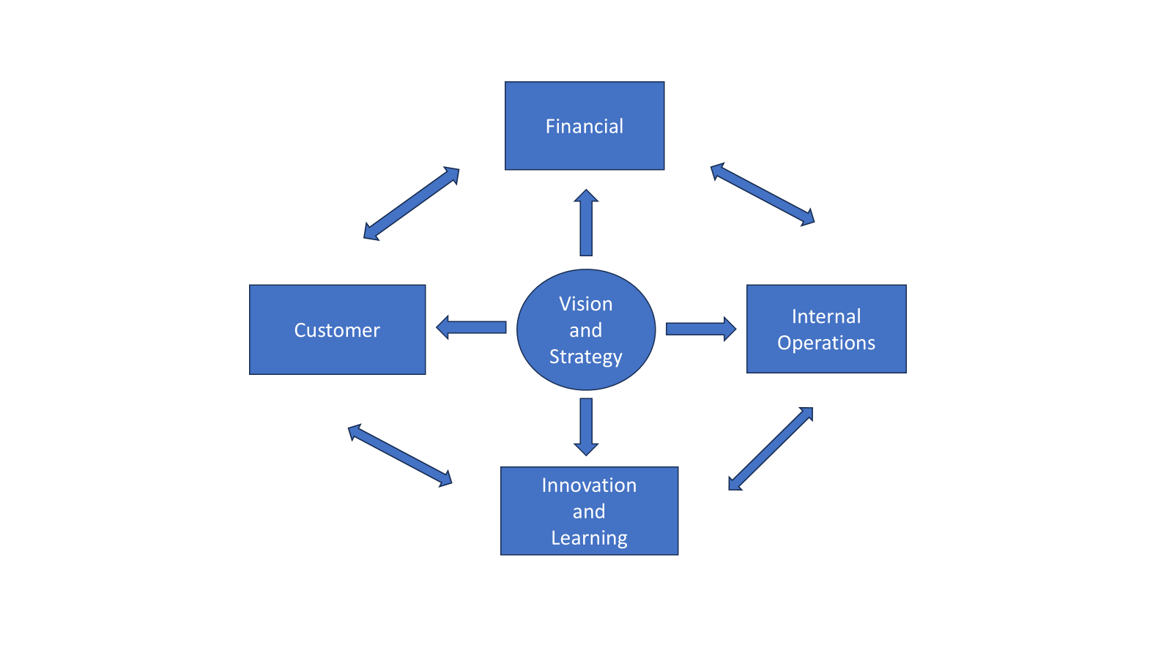

Slide 36
Strategy Maps
An extension of balanced scorecards
Directly links scorecards to business strategy
Shows both the strategy and the processes and systems for implementing the strategy
Help employees link their jobs to the overall objectives of the organization
Show cause and effect links
Show how an organization converts its initiatives and resources into tangible outcomes

Slide 37
Strategy Maps Are Developed from the Top Down
Begins with a review of the mission statement and core values
Then a strategic vision for the company is developed
The strategy should define the logic for arriving at a desired destination
For profit organizations have the learning and growth perspective feeding the internal processes perspective feeding the customer perspective feeding the financial perspective
Not for profit organizations typically place the customer perspective at the top

Slide 38
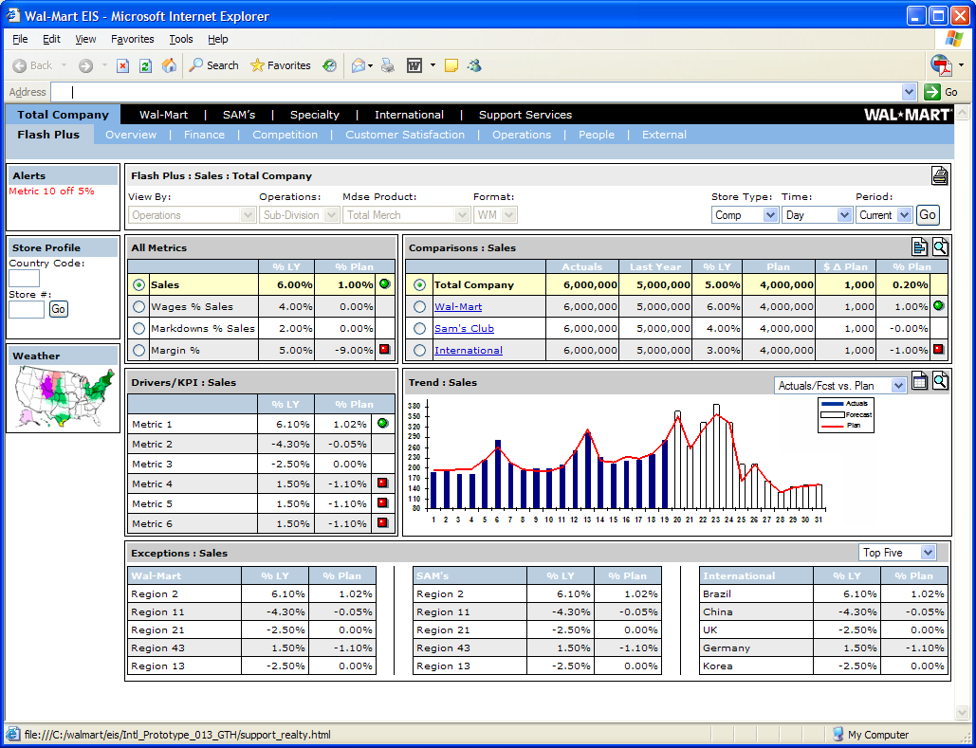
Southwest Airline
Southwest Airline Strategy Map
Strategic Theme (Ground Turnaround)
1
2
3
4
5
Key Process Management
4
5
Fast ground turnaround
On Ground Time
On-Time Departure
30 Minutes
90%
2
3
1
Strategic Job Family
Strategic Job Family
Strategic Job Family
Dashboard
Strategic Job Family
Dashboard
Strategic Job Family
Dashboard
Dashboard
Dashboard
Strategic Themes

Slide 39
A Technology/Application-Based Maturity Model
AI Cognitive Organizations
Big Data Analytics
Real Time Data Warehousing
Enterprise
Data Warehousing
Decision Support Systems
1980
1990
2000
2010
2020
Notes:
Decision-support Systems
The conceptual foundation and early DSS applications emerged in the 1970s, with widespread adoption beginning in the 1980s. These systems focused on supporting a single or a few related decision-making tasks, such as portfolio management, the allocation of officers to police beats or production scheduling. These were interactive systems that helped decision makers use data and models to solve unstructured problems. Because of the technology available at the time (e.g., command language interfaces), these systems were often challenging to build and use. Most of the data was structured, came from a single or few internal systems and was stored in a relational database (which was innovative at the time). These data stores later came to be called independent data marts. Many of the people involved in the DSS field had a management science or operations research background, and not surprisingly, much of the effort focused on the modeling component of the architecture.
DSSs were point solutions and provided value at the application and work unit level. There was not much need for governance given their limited usage. Even with the limitations of what could be done with the available technology, the DSS pioneers envisioned much broader, comprehensive systems (e.g., many different kinds and data sources), many of which are being realized today.
Enterprise Data Warehousing
In the early 1990s, retail, financial services and telecoms firms led the way in the development of enterprise data warehouses (EDWs). These warehouses served as a “single version (or source) of the truth” for organizational data. The data was sourced, transformed, integrated and loaded into the data warehouse, and was used for reporting, OLAP (on-line analytical processing, dashboards/scorecards and other applications (e.g., executive information systems). With data warehousing, the focus was on data and most of the analytics were relatively simple. Data warehouses reduced some of the data inconsistency problems (e.g., “dueling” spreadsheets) and sped up application development because of the data infrastructure that was in place. They also reduced the costs of maintaining multiple independent data marts (though at least a few still remain in nearly all firms today) and, along with advances in data access and analysis tools, led to increases in the BI/analytics user base. Some firms developed operational data stores that maintained the most current data to support operational decision making.
Though data warehouses were challenging to build because of the newness of the concepts and technologies and the shortage of skilled and experienced professionals, the end product had a relatively well-defined, simple architecture. Data governance was given greater attention, in part to try to break down data silos and resolve data-quality and -consistency problems. With enterprise data warehousing, BI/analytics started to be of greater strategic importance and value.
Real-time Data Warehousing
The turn of the century saw the emergence of technology that could better support real-time data warehousing. This technology allowed data (still mostly internal and transactional) to be captured in real time and “trickle fed” (in contrast to traditional batch updates) to the data warehouse. Data became available for analysis within minutes after the business transaction or event occurred. This advancement fundamentally changed the decision-support paradigm by providing support for operational decision making. This was particularly important for customer-facing situations, such as check-in and customer support. It also enabled BI/analytics to support users who perform operational work. Related advances in capturing and storing streaming data and critical event processing (CEP) facilitated the development of rules-based systems to automate decision making, such as fraud detection. The importance of governance continued to grow as data was increasingly recognized as an organizational resource and asset and a source of competitive advantage. Some firms became “analytically based organizations,” with BI/analytics being an enabler of the business strategy. In these organizations, the value of BI/analytics is very high because it is a requirement for competing in the marketplace.
Big Data Analytics
Since around 2010, the headlines have been about big data analytics. Building on the pioneering advances of Internet firms like Google and Yahoo!, there have been tremendous advances in handling “3V” data (high volume, high variety and high velocity). Hadoop/MapReduce, Non-SQL databases, streaming data and other technologies have made it possible to capture, process, store, analyze and use data in ways that were not previously possible. Old and new statistical, mathematical, and machine learning methods and algorithms have been packaged into software products (e.g., Watson Analytics) and, in many cases, made available in the cloud. AI capabilities are being integrated into many BI/analytics products (e.g., recommendations of the best visualization for data). Big data analytics is being used for myriad operational, tactical and strategic applications such as predicting when a part will fail, understanding customers better or assessing the risk of a proposed investment. There is a balance between a focus on data management and modeling with the recognition that each is important and complementary.
Because of the real and perceived value of big data analytics, business units (e.g., marketing) are often obtaining their own analytics resources, sometimes to the consternation of the IT organization. These developments are creating increasingly complex data infrastructures and the need for greater data and analytics governance. The use of BI/analytics has grown and has led to both short- and long-term predictions of shortages of people with deep analytics skills. Firms view BI/analytics as strategically important and are taking greater interest in getting a financial return from their data resources.

Slide 40
Analytics Maturity Model
Strategic Importance
Scope
Models/Applications/Data Focus
Decisions supported
Users
Data Management
The kinds of Analytics
Architectural Complexity
Governance
Value

